Slide 1

COMP 499/691: Conversational Artificial Intelligence
Other Tasks
Computer Science & Software Engineering
Concordia University, Winter 2024

Slide 2
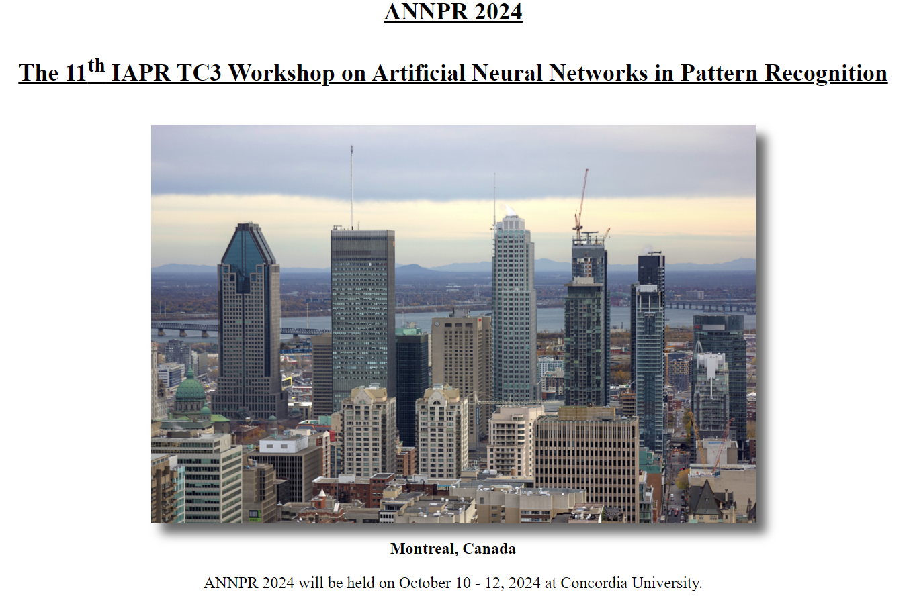
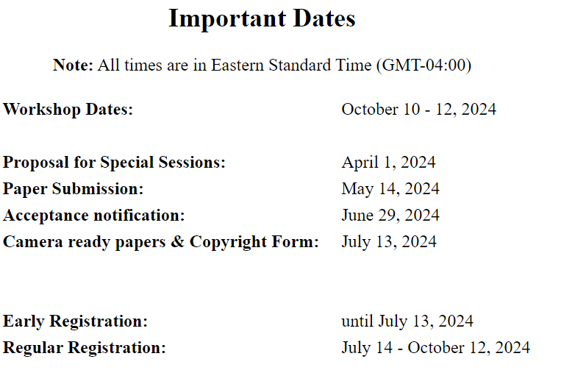
https://users.encs.concordia.ca/~annpr24
Notes:
Maybe there could be a similar tutorial about the Tensorflow ecosystem for speech, but we are just talking about PyTorch because it is the ecosystem where we work.

Slide 3


Final Exam Reminder
The final exam will take place:
April, 24 - 1900:2200 in Room H523
Only Concordia-approved calculators can be used.

Slide 4
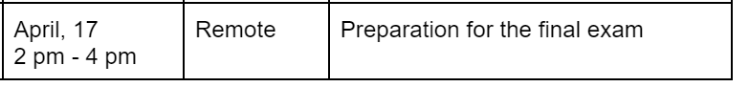


Practice Exam
Later this week, the practice exam will be made available.
We will solve together the practice exam shared in Moodle.
Participation is not mandatory, but highly recommended.
Connect at this zoom link:
https://concordia-ca.zoom.us/j/8734602220

Slide 5
Course Evaluation
Please, fill out the course evaluation form.
This is the official course evaluation conducted by the Centre for Teaching and Learning (CTL).
It is totally anonymous. Please, take 10 minutes to fill out this important form.
Instructions:
Open the browser, go to "My CU Account" (https://hub.concordia.ca/students/account.html) and login
On the left side menu, click on "Academic > Course Evaluation"
Choose a course to evaluate and click on "Evaluate On-line"

Slide 6
Summary of the last episode….
What we have seen last time:
Large Language Models
Today, we will talk about other tasks that might play a role in a conversational AI pipeline:
Voice Activity Detection
Speech Enhancement
Keyword Spotting
Spoken Language Understanding
Dialogue (traditional approaches)
Speech Synthesis

Slide 7

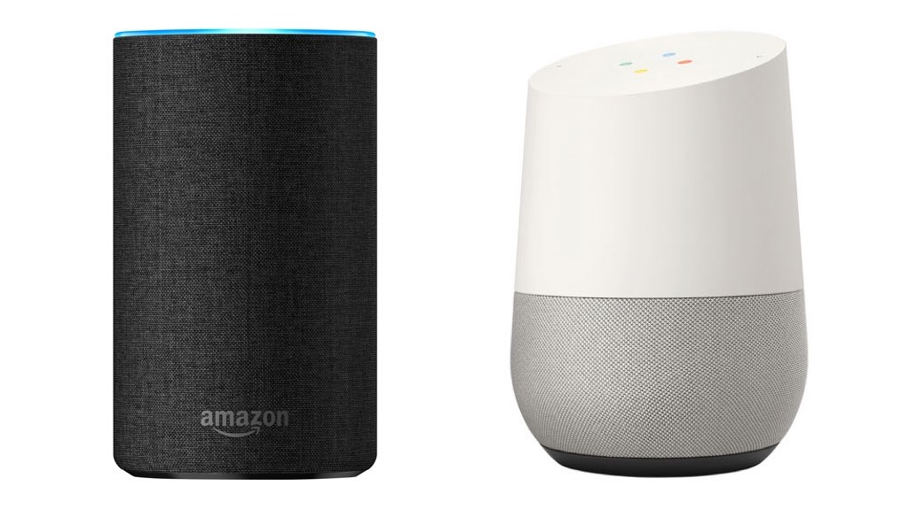


Technologies Involved
In the first lecture, we have seen that many technologies might be involved in a Conversational AI system
Acoustic Environment
Recording Setup
Voice Activity Detection
Speech
Enhancement
Keyword Spotting
Speech Recognition
Acoustic Environment
Generation Setup
Speech Synthesis
Dialogue
Spoken Language Understanding
In this course, we devoted most of the time to describing the essential modules, such as speech recognition, and the latest technologies, including Transformers, Self-supervised learning, and Large Language Models.
Today, we will quickly describe the other modules that might be present in the pipeline of a speech assistant.

Slide 8
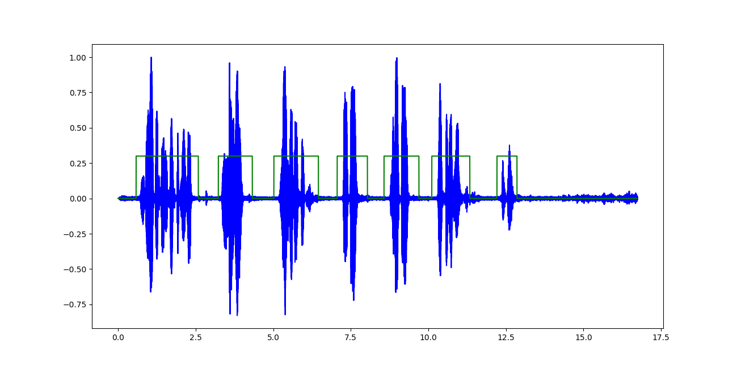
Voice Activity Detection
Let’s start with Voice Activity Detection (VAD):
Acoustic Environment
Recording Setup
Voice Activity Detection
Speech
Enhancement
Keyword Spotting
Speech Recognition
Acoustic Environment
Generation Setup
Speech Synthesis
Dialogue
Spoken Language Understanding
Voice Activity Detection aims to detect which parts of a recording contain speech.

Slide 9

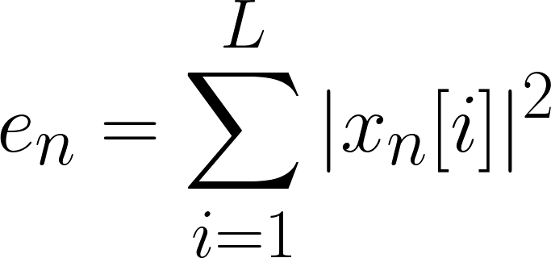
Voice Activity Detection
How can we design a VAD?
Energy-based VAD:
One simple way would be to use energy thresholds.
We split the signal into small chunks.
2. For each chunk we compute the energy:
Energy of chunk n
Signal corresponding to chunk n
3. Apply a threshold:
“0” (non-speech) if e_{n} < threshold
“1” (speech) if e_{n} ≥ threshold

Slide 10


Voice Activity Detection
Advantages and disadvantages of energy-based VADs:
Easy to implement
Efficient
Bad Performance
Several high-energy signals, such as vacuum cleaners, music, and ringing phones, are non-speech in nature.
Due to this limitation, an energy-based VAD can be used to pre-screen a speech recording and trigger a more complex VAD only in the speech-marked regions.

Slide 11
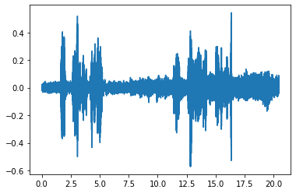
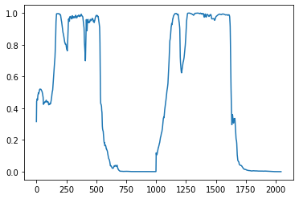
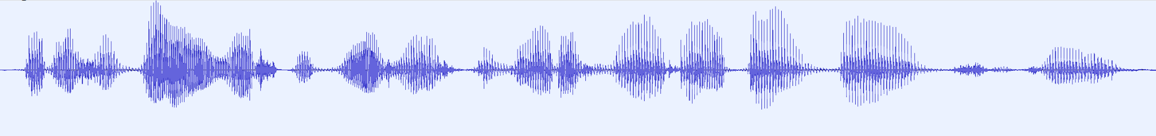
Voice Activity Detection
What about using neural networks?
The neural network outputs a probability (speech vs non-speech) at each time step:
0.1, 0.5, 0.5, .. 0.0
Output probabilities
Original Signal
Neural Network
CNN, RNN,
CRDNN, Transformer
Output Probabilities
e.g., FBANKs
Speech Features

Slide 12
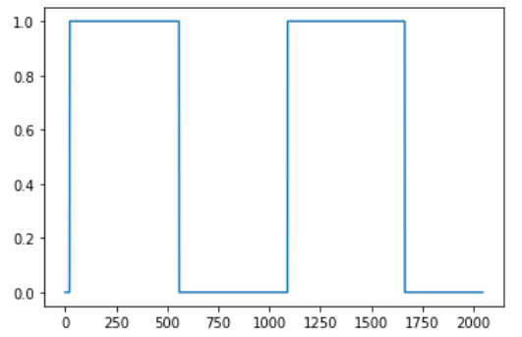
Voice Activity Detection
How can we convert probabilities to binary values (0 for non-speech and 1 for speech) for each time step?
Original Signal
Output Probabilities
Final Output
Neural
Network
Segmentation
The simplest way is to apply a threshold (e.g, 0.5) on top of the output probabilities.
We commonly employ additional heuristics to refine the output probabilities, such as smoothing, avoiding excessively brief segments, or merging adjacent segments.

Slide 13
Voice Activity Detection
In some cases (e.g., speech assistants), the VAD should produce a continuous output while recording the data (online VAD).
This requires the neural network to be streamable and produce an output in real-time (or with low latency).
A streamable neural network has access to the past and present elements, but not to the future ones.
How can we make a convolutional layer streamable?
Filter
We do not have access to future elements!
The standard convolution is non-causal (i.e., it is using both past, present, and future elements).
We have access to present and past elements!
t=n
Time

Slide 14
Voice Activity Detection
One way is to set the weights corresponding to the future to 0 during training (and freeze them).
Filter
We can set these weights to 0 and freeze them during training.
For more info on VAD using SpeechBrain, take a look at this tutorial.
t=n
Time
How can we make a Transformer Encoder streamable?
Just mask future elements.
How can we make an RNN streamable?
Just use a unidirectional RNN

Slide 15
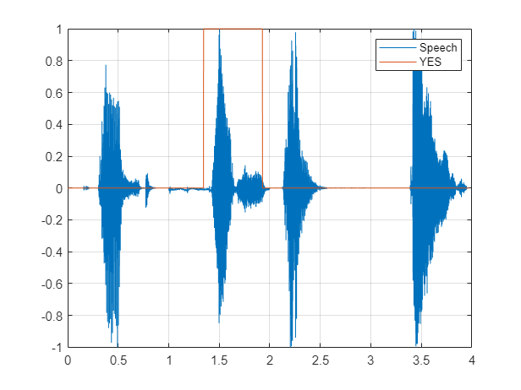
Keyword Spotting
Keyword spotting is a task that closely resembles Voice Activity Detection.
Its objective is to identify the presence and location of a specific keyword in an audio recording.
Also in this case, we use a neural network that outputs probabilities.
We then apply a threshold on top of them or use a more sophisticated heuristic to determine when and where the keyword is pronounced.

Slide 16
Speech Classification
Several speech tasks involve classifying speech recordings of varying lengths.
This type of tasks has been presented in previous tutorials and labs, such as accent and emotion classification.
CNNs, RNNs, and Transformers can be utilized.
Regardless of the chosen model, there is a requirement to transform a variable-length representation into a fixed-sized vector, which is independent of the length of the input signal.
How can we do that?

Slide 17
Speech Classification
The simplest approach is to average all the representations over the time axis.
Mean(*, dim=1)
MLP classifier
output
channels
[batch,time,channels]
time
[batch,channels]
Conv layer 2
Conv1d
Layernorm
Leaky ReLU
This way, we obtain a single vector whose length is independent of the length of the original signal.
Conv layer 2
Conv1d
Layernorm
Leaky ReLU
Conv1d
Layernorm
Leaky ReLU
The neural network will learn how to summarize in this vector all the information that is relevant to perform the classification task.
Conv layer 1
On top of this vector, we can use an MLP classifier.

Slide 18
Speech Classification
Statistical Pooling is an improvement of the previous approach.
[batch,time,channels]
Mean(*, dim=1)
channels
Concatenate
MLP classifier
output
time
Std(*, dim=1)
Conv layer 2
Conv1d
Layernorm
Leaky ReLU
[batch,2*channels]
Conv layer 2
Conv1d
Layernorm
Leaky ReLU
We compute both the mean and the standard deviation (over the time axis).
Conv layer 1
Conv1d
Layernorm
Leaky ReLU
We concatenate them and feed them into an MLP classifier.

Slide 19
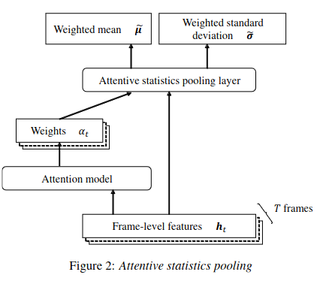

Speech Classification
A more sophisticated approach is Attentive Statistical Pooling (see paper)
For more info on speech classification using SpeechBrain, see this tutorial.
The idea here is to use weighted mean and weighted standard deviations.
This is because not all the time steps are equally important to perform the classification.
The weights are derived with an attention mechanism. (see SpeechBrain implementation here).
These techniques can be applied to any time series of variable length (e.g., EEG, EMG, videos, etc).

Slide 20

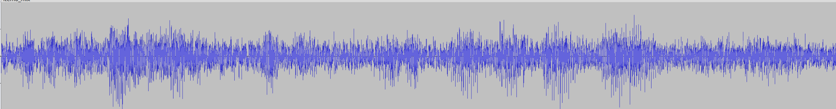
Speech Enhancement
Another task of common interest is speech enhancement.
Noisy Signal
Acoustic Environment
Recording Setup
Voice Activity Detection
Speech
Enhancement
Keyword Spotting
Speech Recognition
Speech Enhancement
Acoustic Environment
Generation Setup
Speech Synthesis
Dialogue
Spoken Language Understanding
Clean
The goal of speech enhancement is to improve the quality of the speech signal by removing noise and reverberation.

Slide 21
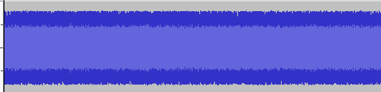
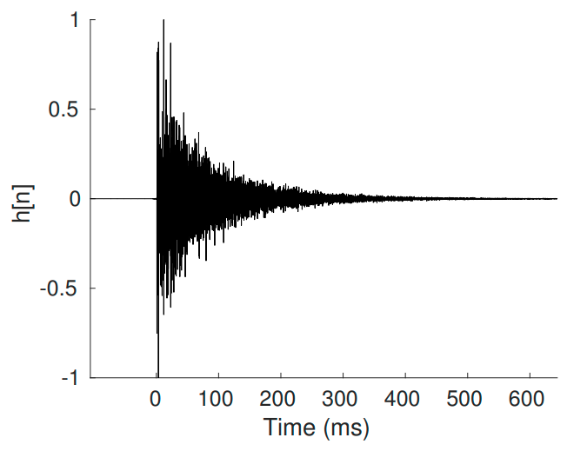
Speech Enhancement
Traditional Speech Enhancement systems were based on signal processing.
Today the dominant approach is neural networks.
How can we train it?
Noisy Signal
Clean Speech
Clean
dataset
Neural Network
CNN
RNN
Transformer
(Encoder)
Noise Sequence
Noise
dataset
Add Noise
Add Reverb
Impulse Response
IR dataset
Clean
Noisy data
We use MSE (between the clean and enhanced speech) as a loss.

Slide 22
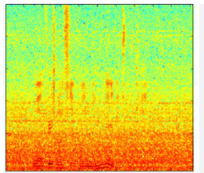
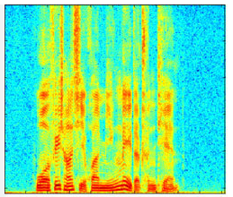

Speech Enhancement
As we have seen, working with the raw waveform directly is challenging.
Often, speech enhancement systems operate in the frequency domain.
Neural Network
CNNs, RNNs, Transformers
Noisy Spectrogram
Enhanced Spectrogram
This way we make it simpler for the network to learn the input/output mapping.
The output is now a spectrogram (i.e., an image), we need to retrieve the audio waveform to be able to hear and play it!

Slide 23
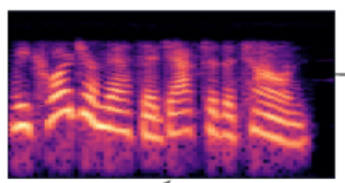
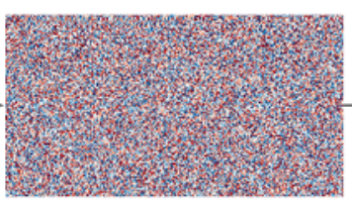
Speech Enhancement
When computing the magnitude of the Fourier transform (i.e., the basic building block of the spectrogram), we get rid of the phase information.
One way is to estimate the phase information as well (which is equivalent to using the STFT with real and imaginary part directly).
Magnitude of the STFT (spectrogram)
Phase of the STFT (phase)
There is growing interest in these approaches, but estimating the phase is challenging as it is very “noisy”.

Slide 24
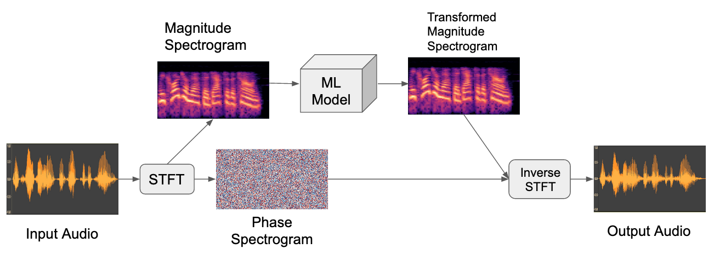
Speech Enhancement
An easier way is to reuse the phase information of the original noisy signal in input.
This approach works reasonably well in practice.

Slide 25

Speech Enhancement
The state-of-the-art speech enhancement models are based on a masking approach.
The idea is to estimate a “soft-mask” (with numbers between 0 and 1) to extract the clean signal from the noisy one.
The mask is close to 1 if the time-frequency bin contains speech, close to 0 if it contains noise.
0.1 | 0.2 | 0.0 | 0.0
0.2 | 0.5 | 0.7 | 0.0
0.3 | 0.8 | 0.6 | 0.1
0.1 | 0.9 | 1.0 | 0.0
Neural Network
x
CNNs, RNNs, Transformers
Enhanced Spectrogram
Noisy Spectrogram
Mask
Estimating a mask is easier than estimating a full spectrogram because the network only needs to focus on the relatively small changes necessary to clean up the noisy spectrogram.

Slide 26
Speech Enhancement
It is often better to not estimate a mask at the end, but estimate a mask applied to a latent representation (see paper):
Mask
Estimation
CNN, RNN, Transformer
Encoder
Decoder
x
CNN
Transposed Convolution
Noisy Spectrogram
Enhanced Spectrogram
The encoder is a simple neural network (e.g., a CNN) that converts the input into a latent representation.
On top of that, we estimate a mask. An enhanced latent representation is derived by multiplying it with the encoded representation.
A decoder predicts the enhanced output (e.g., using transposed convolutions).
This architecture has been used with both the raw waveform (e.g., Convtasnet) or spectrogram in inputs.

Slide 27
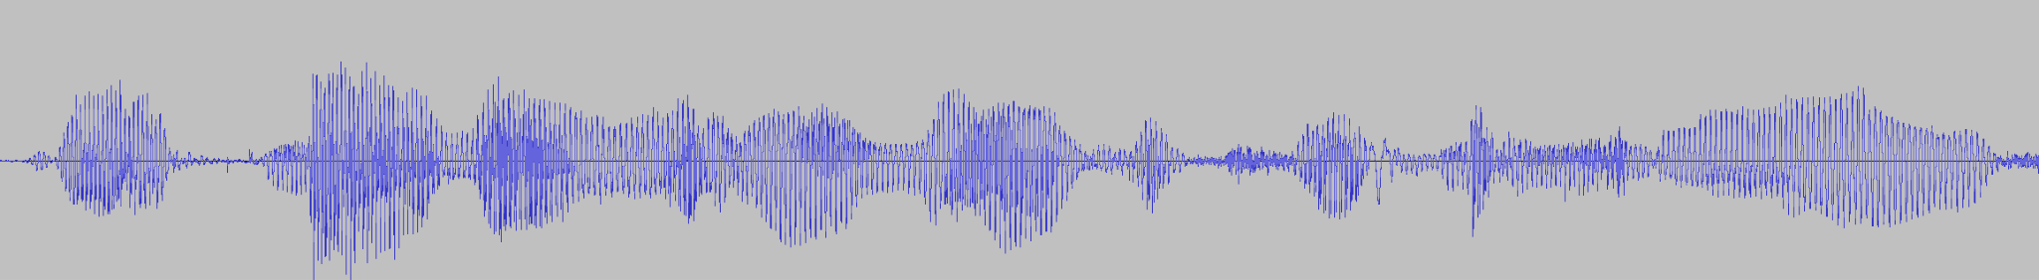
Speech Separation
A related task is speech separation.
The goal of speech separation is to separate a speech signal where multiple speakers are speaking at the same time (mixture).
Separated Signal 1
Mixture
Speech Separation
Separated Signal 2
We can train the model by artificially generating mixtures.

Slide 28
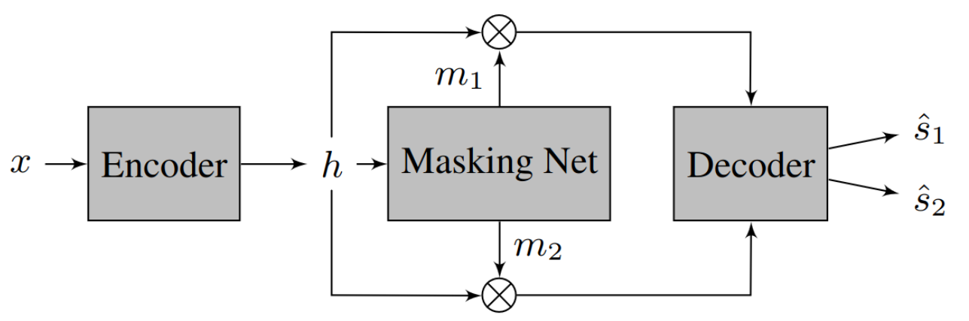

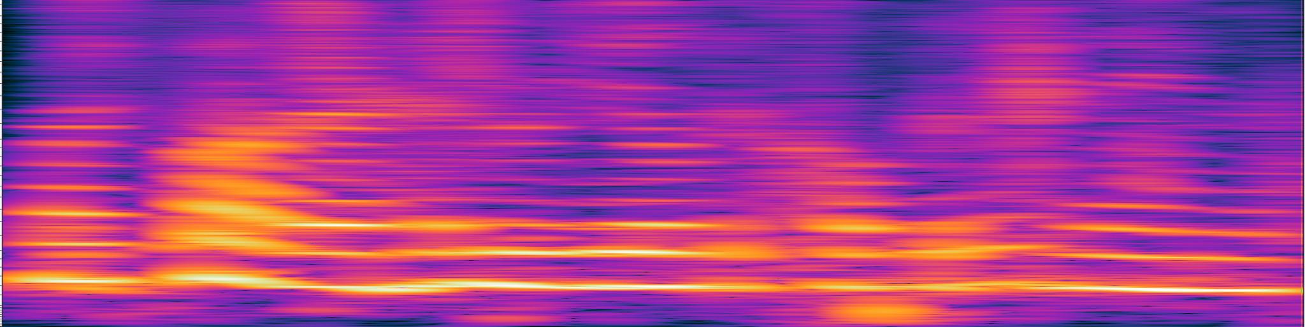

Speech Separation
There is a vast literature on speech separation as well.
Similar to speech enhancement, modern separation approaches are mask-based:
The main difference with speech enhancement is that we here estimate one mask for each speaker in the mixture.
Speech separation models can work both in the time or frequency domain.

Slide 29

Speech Separation
A popular model for speech separation is the Separation Transformer (SepFormer, see paper)
It is a Transformer specifically redesigned for speech separation.
Transformers archive state-of-the-art performance in separation as well.
More info on speech enhancement and separation with SpeechBrain here:
Tutorial on Speech Enhancement
Tutorial on Speech Separation

Slide 30
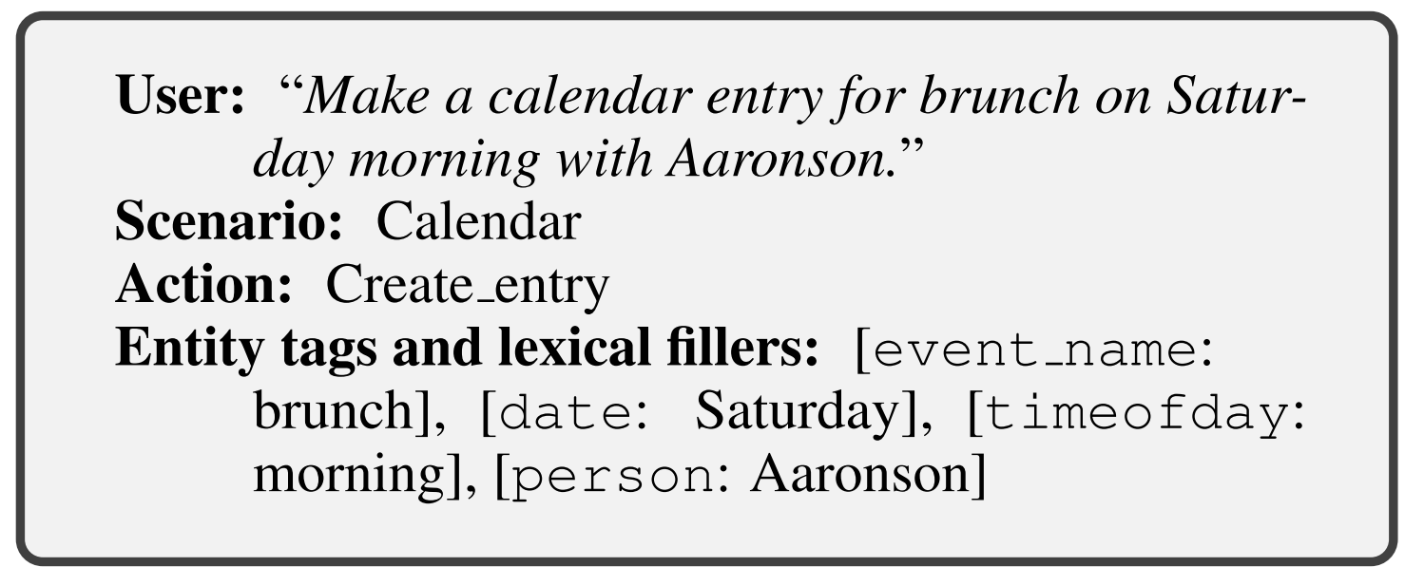
Spoken Language Understanding
Spoken Language Understanding (SLU) aims to extract the meaning of a spoken sentence.
Acoustic Environment
Recording Setup
Voice Activity Detection
Speech
Enhancement
Keyword Spotting
Speech Recognition
Acoustic Environment
Generation Setup
Speech Synthesis
Dialogue
Spoken Language Understanding
Input
output

Slide 31
Spoken Language Understanding
Spoken Language Understanding can be useful within a dialogue system or can be used for reservation systems, customer services, and many other applications.
We need to define some semantic ontology (compatible with our application)
The goal of the system is to fill the intents and slots of the predefined semantics.
Intents: are the goal(s) of a user request.
For example, if a user says "Book a flight from New York to Los Angeles," the intent is to “Book a flight”.
Slots: they refer to the specific pieces of information that are required to fulfill the user's intent.
For example, in the above request, the slots would include the departure location (New York) and the destination location (Los Angeles).

Slide 32
Spoken Language Understanding
One way to approach this problem is by using an ASR system followed by a Natural Language Understanding module:
Both systems can be implemented with neural nets
Semantic
Representation
{
intent: “book a flight”,
departure: “New York”,
location: “Los Angeles”
}
Speech Recognition
Text
Natural Language Understanding
“Book a flight from New York to Los Angeles”
Another way, called end-to-end SLU, consists of directly estimating the semantic representation from the input speech signal:
{
intent: “book a flight”,
departure: “New York”,
location: “Los Angeles”
}
End2End
SLU
Text
“Book a flight from New York to Los Angeles”

Slide 33
Dialogue
The dialogue system aims to reply to requests from users.
Hi, I want to reserve a restaurant today.
Acoustic Environment
Recording Setup
Voice Activity Detection
Speech
Enhancement
Keyword Spotting
Dialogue System
Speech Recognition
Acoustic Environment
Generation Setup
Speech Synthesis
Dialogue
Spoken Language Understanding
Which kind of food do you want to eat?
In the previous lecture, we have seen how we can turn large language models into dialogue systems.
This is the current trend, but not the only way to go!

Slide 34

Dialogue
The literature on dialogue systems is vast (we would need an entire course just for that!)
Dialogue systems can be roughly categorized into two groups:
Task-oriented systems: are specifically designed to assist the user to complete certain tasks (e.g. finding products, and booking accommodations and restaurants).
Non-task-oriented systems: are designed to engage in open-domain conversations with users (these systems are also known as chatbots).
Chat-GPT is an example of non-task-oriented systems.

Slide 35
Dialogue
Imagine we have a large language model (e.g, GPT3), how can we turn it into a task-specific dialogue system?
If we have a supervised dataset for our task of interest, we can fine-tune the large language model if this dataset.
This is a modern approach, that we followed in one of the tutorials.
What is the main issue with this approach?
The model that we use will be very computationally demanding at inference time as well.
In many practical applications, we might want to use models that are more computationally efficient.
This is where “traditional” task-oriented dialogue systems can be very helpful.

Slide 36
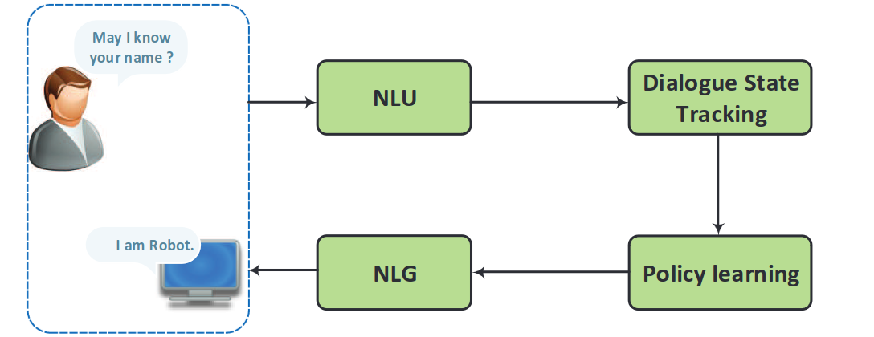
Dialogue
Traditional Task-oriented systems are based on a pipeline of different modules:
Dialogue Manager (DM)
The Natural Language Understanding modules has the goal of extracting the user's intent and relevant information from the input text:
Input:
"Book a table for two at an Italian restaurant near my location for tomorrow evening."
These days neural networks can be successfully used for this task.
Output:
Intent: “Book a table”
Slots:
Number: 2
Cuisine: Italian
Location: near my location
Date and Time: tomorrow evening
Rule-based systems, statistical methods, and probabilistic models are alternatives to neural nets.

Slide 37
Dialogue
Traditional Task-oriented systems are based on a pipeline of different modules:
Dialogue Manager (DM)
The Dialogue State Tracker (DST) tracks the current state of the conversation.
It estimates the user’s goal at every turn of the dialogue.
It considers the dialogue history and the current semantic representation given by the NLP system to update the dialogue state (semantic frame).
Neural networks are the dominant approach.
Other approaches are rule-based methods, statistical methods, and other machine learning methods.

Slide 38
Dialogue
Initial dialogue state
Dialogue State Update:
{
"task": "book_flight",
"inform": {
"origin": null,
"destination": null,
"departure_date": null,
"return_date": null,
"num_adults": null,
"num_children": null
}
}
{
"task": "book_flight",
"inform": {
"origin": "San Francisco",
"destination": "New York",
"departure_date": "2023-07-15",
"num_adults": 2,
"num_children": 1
}
}
Turn 1: User: "I want to book a flight from San Francisco to New York on July 15th for two adults and one child."
{
"task": "book_flight",
"inform": {
"origin": "San Francisco",
"destination": "New York",
"departure_date": "2023-07-15",
"num_adults": 2,
"num_children": 1,
"departure_time": null
}
}
Turn 2: System: "Sure, we have several flights available on July 15th. Would you like to depart in the morning or afternoon?

Slide 39
Dialogue
{
"task": "book_flight",
"inform": {
"origin": "San Francisco",
"destination": "New York",
"departure_date": "2023-07-15",
"num_adults": 2,
"num_children": 1,
"departure_time": morning
}
}
Turn 3: User: "I prefer a morning departure."
Turn 4: System: "Great, we have a flight leaving at 9am and arriving in New York at 5pm. Would you like to book this flight?"
{
"task": "book_flight",
"inform": {
"origin": "San Francisco",
"destination": "New York",
"departure_date": "2023-07-15",
"num_adults": 2,
"num_children": 1,
"departure_time": "morning",
"flight_id": "12345",
"arrival_time": "5pm"
}
}

Slide 40
Dialogue
Dialogue Final State:
Turn 5: User: "Yes, please book the flight."
{
"task": "book_flight",
"inform": {
"origin": "San Francisco",
"destination": "New York",
"departure_date": "2023-07-15",
"num_adults": 2,
"num_children": 1,
"departure_time": "morning",
"flight_id": "12345",
"arrival_time": "5pm",
"booking_status": "reserved"
}
}

Slide 41
Dialogue
Traditional Task-oriented systems are based on a pipeline of different modules:
Dialogue Manager (DM)
Dialog policy decides what and how a task-oriented dialog system will respond.
Its goal is to learn an optimal policy that maps the current dialogue state to the best system action to take to achieve the desired task or goal.
The policy can be represented as a set of rules, heuristics, or machine learning models.

Slide 42
Dialogue
The possible system actions are typically represented using a semantic representation.
Dialogue State:
Action:
{
"task": "book_flight",
"inform": {
"origin": "San Francisco",
"destination": "New York",
"departure_date": "2023-07-15",
"num_adults": 2,
"num_children": 1,
"departure_time": "morning"
}
}
System action: GetFlightOptions
Ontology representation:
DepartureCity: New York
ArrivalCity: San Francisco
DepartureDate: June 15th
DepartureTime: Morning
ReturnDate: null
FlightOptions:
Flight 1:
Airline: Delta
DepartureTime: 9:00 AM
ArrivalTime: 12:30 PM
Price: $250
Flight 2:
Airline: United
DepartureTime: 11:00 PM
ArrivalTime: 2:30 PM
Price: $300
We might need to interrogate a database with flight information.

Slide 43
Dialogue
Traditional Task-oriented systems are based on a pipeline of different modules:
Dialogue Manager (DM)
The Natural Language Generation (NLG) module generates natural language responses that are appropriate and relevant to the user's input.
Many modern NLGs are based on neural networks. Other machine learning models or rule-based systems can also be used for NLU.
Action:
NLU:
System action: GetFlightOptions
Ontology representation:
DepartureCity: New York
ArrivalCity: San Francisco
DepartureDate: June 15th
DepartureTime: Morning
ReturnDate: null
FlightOptions:
Flight 1:
Airline: Delta
DepartureTime: 9:00 AM
ArrivalTime: 12:30 PM
Price: $250
Flight 2:
Airline: United
DepartureTime: 11:00 PM
ArrivalTime: 2:30 PM
Price: $300
We have two options for a flight between New York and San Francisco in the morning of June ,15: One starts at 9.00 am …..

Slide 44
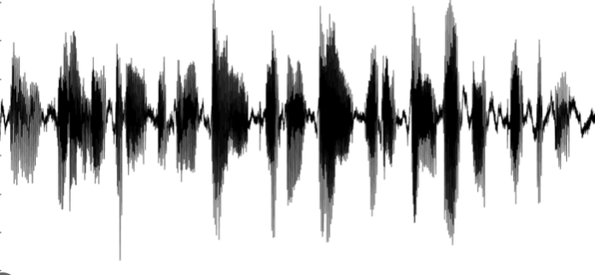
Speech Synthesis
The goal of speech synthesis is to generate a speech signal for a given input text (text-to-speech),
Acoustic Environment
Recording Setup
Voice Activity Detection
Speech
Enhancement
Keyword Spotting
Speech Recognition
Acoustic Environment
Generation Setup
Speech Synthesis
Dialogue
Spoken Language Understanding
Welcome to the world of Conversational Artificial Intelligence
Speech Synthesis

Slide 45
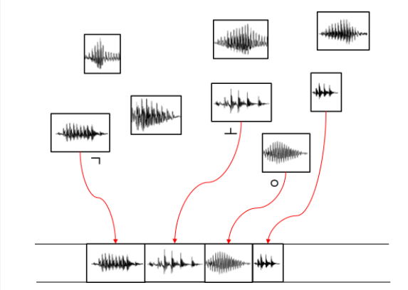
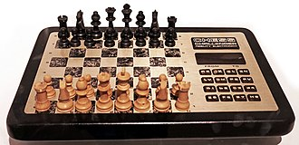
Speech Synthesis
Traditional Text-to-Speech systems were based on concatenative approaches.
The speech signals were created by combining small pre-recorded segments of sound, typically representing phonemes or phoneme combinations.
An early attempt (1979):
The main issues were selecting the right segments from the dataset and combining them to minimize discontinuities and artifacts.

Slide 46
Speech Synthesis
Despite significant improvements over the decades, concatenative speech synthesis tends to generate “flat” and “robotic” voices.
These days, we can create high-quality and very expressive voices with deep learning:
Welcome to the world of Conversational Artificial Intelligence
Neural
Network
CNN, RNN, Transformers
Neural networks can learn long-term dependencies.
Thanks to that, the synthetized speech sounds much more natural, fluent, and with the expected prosody.

Slide 47
Speech Synthesis
As estimating the raw waveform directly is hard, we normally have a pipeline of two components:
Spectrogram
Acoustic Model
Vocoder
Text
CNN, RNN, Transformers
Waveform
The acoustic model is a neural network that converts the input text into a spectrogram.
Then another neural network called vocoder maps the spectrogram into the waveform.
The acoustic model and the vocoder can be trained separately.

Slide 48
Speech Synthesis
Many neural TTS models have been proposed in the last few years.
Examples of popular ones are:
Tacotron2 (see paper)
Fastspeech2 (see paper)
TransformerTTS (see paper)
In the tutorial this week, we will focus on Tacotron2.

Slide 49
References
[1] https://www.danielpovey.com/files/2018_icassp_xvectors.pdf
[2] https://arxiv.org/abs/2005.07143
[3] https://arxiv.org/abs/1803.10963
[4] https://arxiv.org/pdf/1809.07454.pdf
[5] https://arxiv.org/abs/1910.06379
[6] https://arxiv.org/abs/2010.13154
[7] https://arxiv.org/abs/1711.01731
[8] https://arxiv.org/abs/1712.05884
[9] https://arxiv.org/abs/2006.04558
[10] https://arxiv.org/abs/1809.08895

Slide 50

Lab Session
During the weekly lab session, we will do:
Speech Synthesis with Tacotron2
Generative Language Models (from scratch)
Deadline: April, 17 11.59 pm

Slide 51


